Slide 1
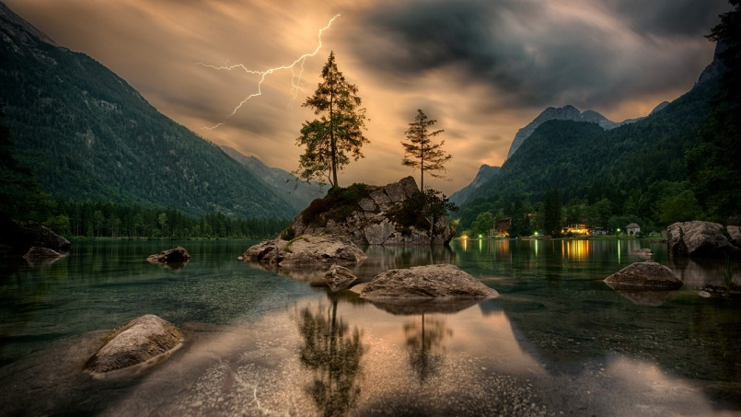
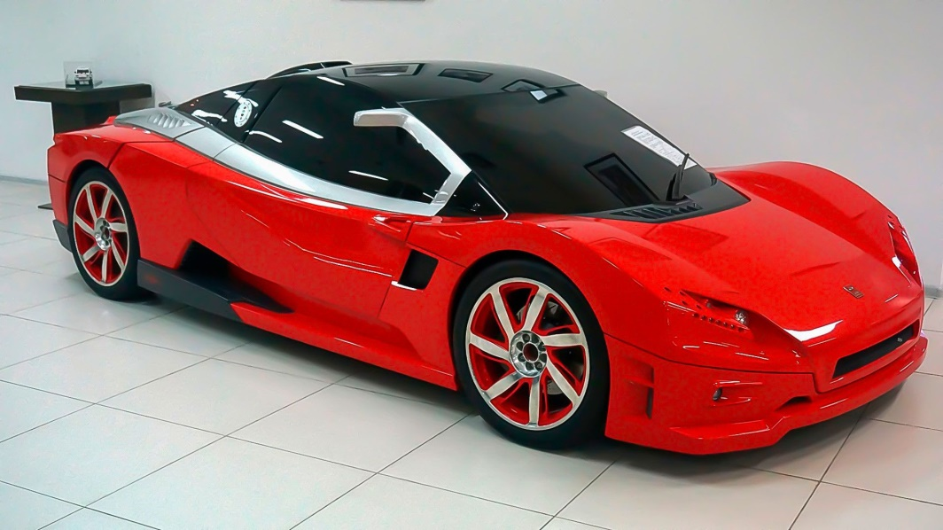
Quiz
[variable field="##user.Name##" /]
[variable field="##user.Email##" /]
[variable field="##user.FirstName##" /]
[variable field="##user.LastName##" /]
Question and Answer
Samples and Techniques

Slide 2
The Sun is a star.
[variable field="##company.Name##" /]
[variable field="##company.Address1##" /]
[variable field="##company.Address2##" /]
[variable field="##company.City##" /]
[variable field="##company.State##" /]

Slide 3
What is the name of our galaxy?
The Milky Way

Slide 4
How many planets in the solar system have rings?
Four planets.
Jupiter, Saturn, Uranus, and Neptune all have rings.

Slide 5
What is inertia?
Measurement of electrical resistance
A ratio between mass and velocity
Resistance to motion or change
The speed at which an object falls
All of the above

Slide 6
Match the device to what it measures:
Stop Watch
Distance
Scale
Temperature
Thermometer
Elapsed Time
Speedometer
Weight
Odometer
Rate of Travel

